Slide 1
I. C. “A. MORO”
SOLBIATE OLONA
S.I.M.P.L.E
LAVA BUBBLES

Slide 2
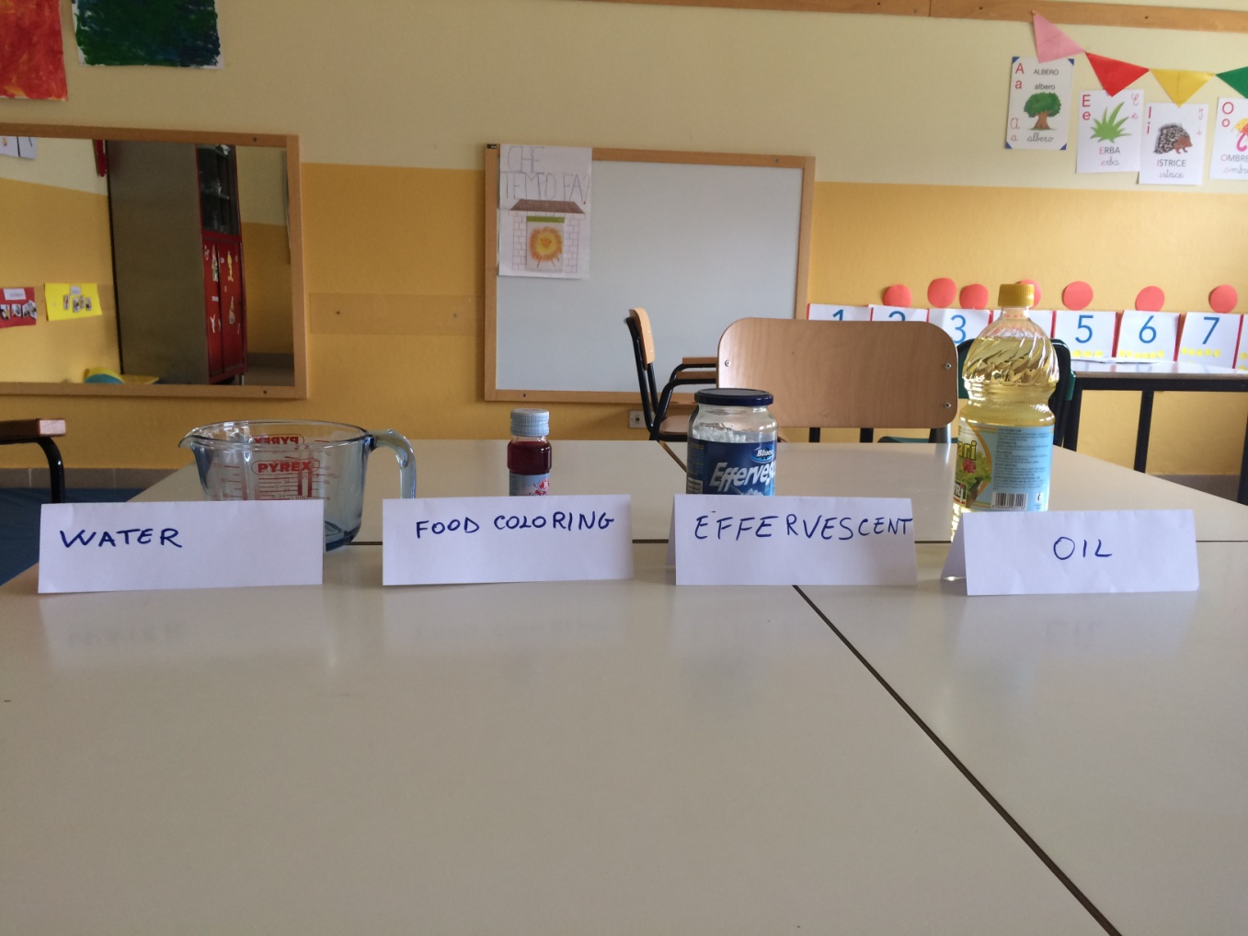
NECESSARY ELEMENTS

Slide 3
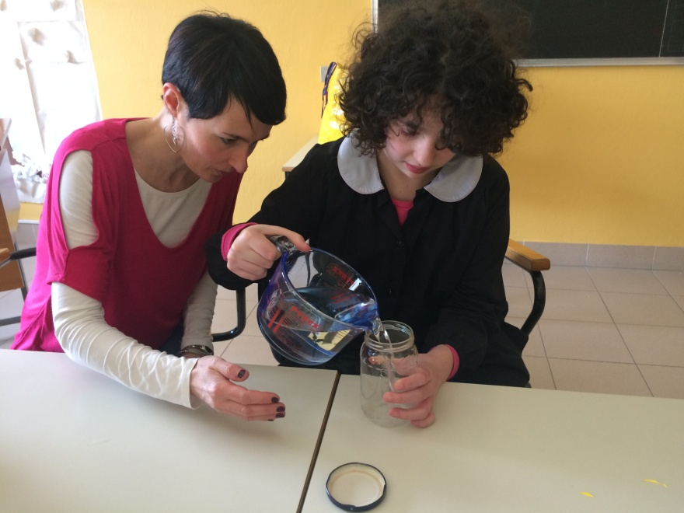
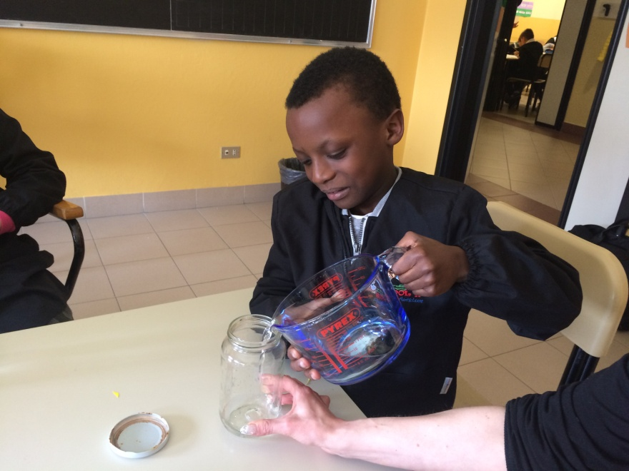
FIRST STEP:
POUR THE WATER INTO THE CONTAINER

Slide 4
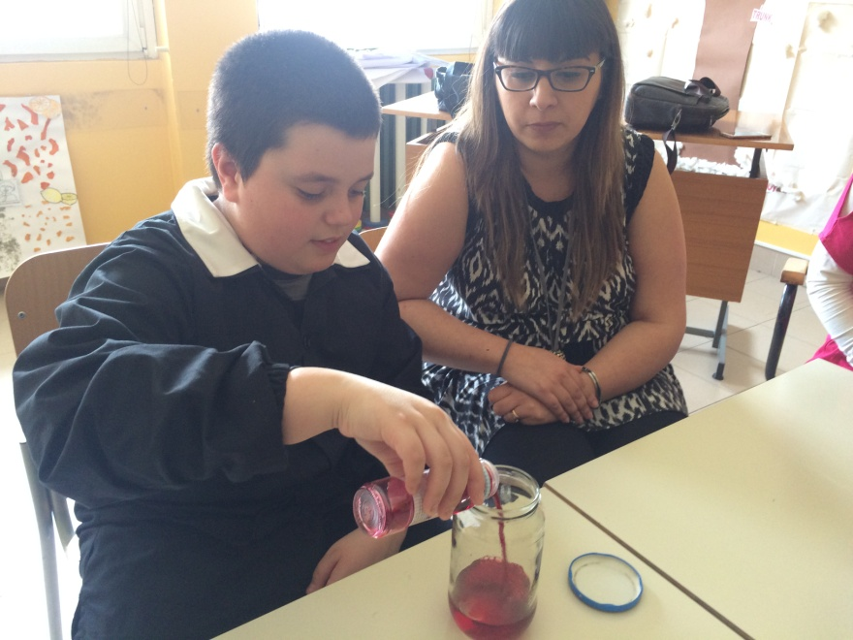
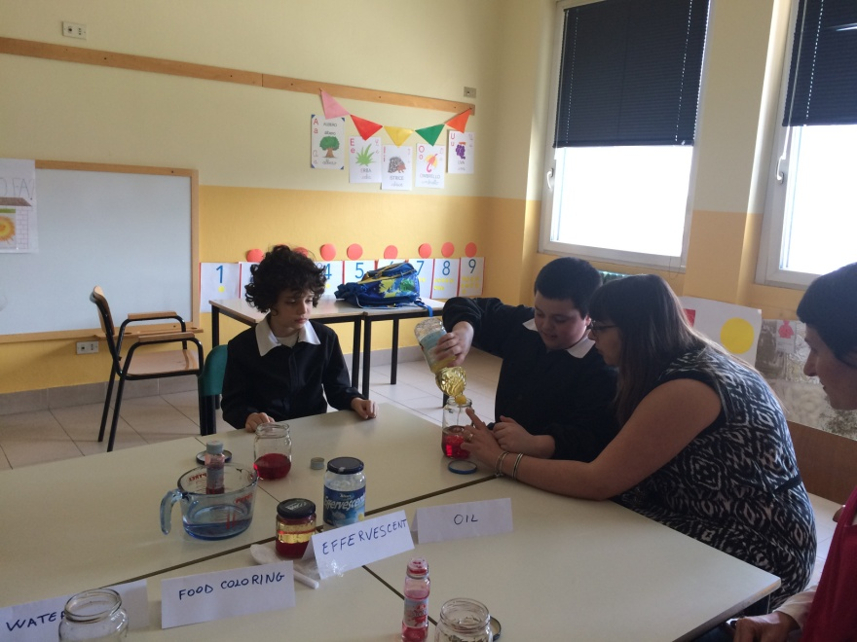
SECOND STEP:
ADD FOOD COLORING AND OIL

Slide 5
ADD EFFERVESCENT AND
WAIT FOR……..

Slide 6
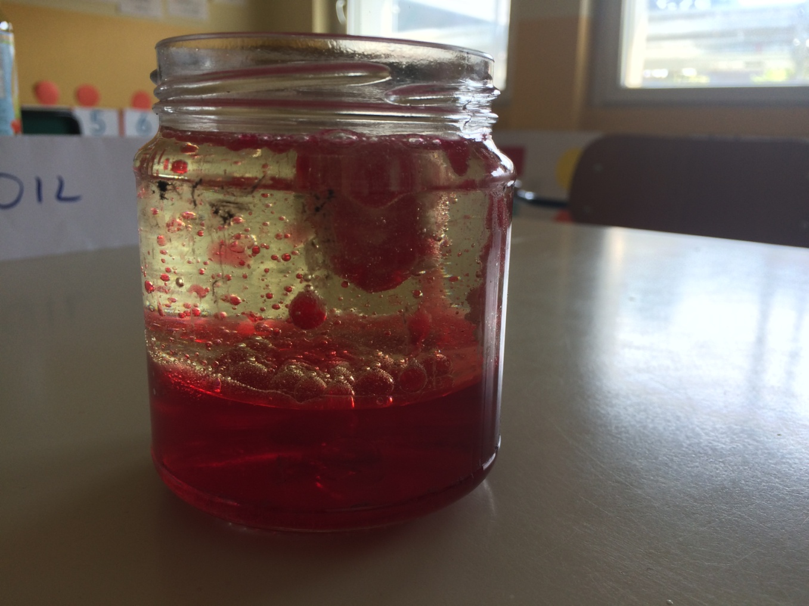
SUCCESSFUL EXPERIMENT

